Slide 1



Keyword Gap Analysis
x
Interactive Competitive Intelligence

Slide 2
The Concept
In most markets, there are organizations who have “been there, and done that.” While sometimes, that can be considered a disadvantage, we see it differently.
The Keyword Gap Analysis works to uncover what is working for a strategically-selected set of industry search competitors, and the final deliverable allows us to uncover keyword opportunities we otherwise would have missed.
These keywords will drive strategy for new content for your website - from resource pages to product and service pages.

Slide 3
Your Competition
We agreed on a select set of competitors. At a high-level, here are their metrics:
You
Comp 1
Comp 2
Comp 3
Comp 4
Comp 5
Logo
Logo
Logo
Logo
Logo
Logo
1.5k Visitors/mo
1.5k Visitors/mo
1.5k Visitors/mo
1.5k Visitors/mo
1.5k Visitors/mo
1.5k Visitors/mo
2.8k Keywords
2.8k Keywords
2.8k Keywords
2.8k Keywords
2.8k Keywords
2.8k Keywords
300 Top-3 Keywords
300 Top-3 Keywords
300 Top-3 Keywords
300 Top-3 Keywords
300 Top-3 Keywords
300 Top-3 Keywords

Slide 4
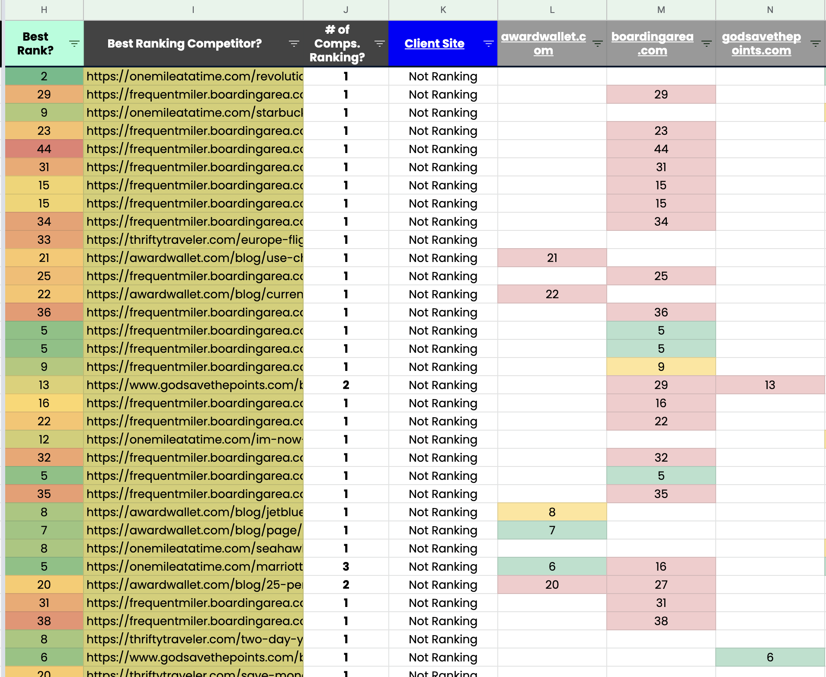
The Process - Step 1: Gathering The Data
We start by scraping a list of keywords your competitors are ranking for.
We take your competitor rankings and blend that with your rankings to create a comparative report.
We use this data to sort keywords for which you’re not currently ranking well.

Slide 5
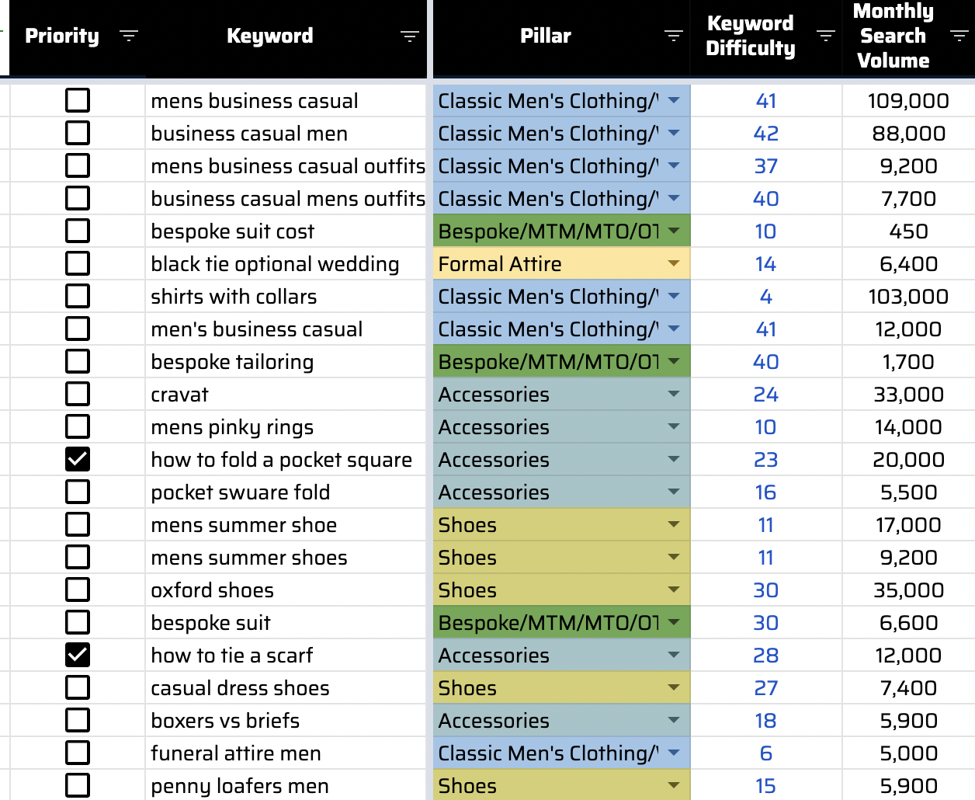
The Process - Step 2: Cleanup & Categorization
After we have the data available, we manually check each keyword and discard those which are not relevant.
We then categorize each relevant keyword, line-by-line, into its respective pillar and cluster for your website.

Slide 6
What We Learned

Slide 7
Keyword Opportunities by Pillar
Pillar | Number of Keywords | Total Search Volume | Average KW Difficulty
Flights | 56 | 10000 | 10
Hotels | 280 | 105930 | 2.6
Trains | 120 | 30 | 3.4
Ferries | 443 | 54500 | 5
Total | XXX | XXX | XXX

Slide 8
Keyword Opportunities by Micro-Moment
Pillar | Number of Keywords | Total Search Volume | Average KW Difficulty
Dreaming Moments | 56 | 10000 | 10
Planning Moments | 280 | 105930 | 2.6
Booking Moments | 120 | 30 | 3.4
Experiencing Moments | 443 | 54500 | 5
Total | XXX | XXX | XXX

Slide 9
How To Use The Gap Analysis

Slide 10
Thank You

